Slide 1
Developing the client-side
Dynamic use of templates in Jinja2

Slide 2
Base.html
<!DOCTYPE html> <html lang="en"> <head> <title>Title</title> </head> <body> <h1> This heading is common in all webpages </h1> {% block content %} {% endblock %} </body> </html>
Create a base page we use base.html
{% block <name> %}
(where name = ‘content’) to start the block.
end the block you simply use
“{% endblock %}”
this will copy everything below it

Slide 3
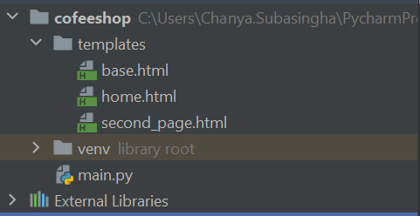
First page and second page using base content
{%extends "base.html" %} {% block content %} <p>Page one.</p> {% endblock %}
{%extends "base.html" %} {% block content %} <H2> This is the heading of the second page</H2> <p> Some more text</p> {% endblock %}
Add two pages extending base.html

Slide 4
Update the main.py file
@app.route('/') def index(): return render_template('home.html')
@app.route('/second_page') def index(): return render_template('second_page.html')
Add routing for the second page.

Slide 5
Dynamic URLs
@app.route('/post/<int:id>') def show_post(id): # Shows the post with given id. return f'This post has the id {id}’ @app.route('/user/<username>') def show_user(username): # Greet the user return f'Hello {username} !’
--------------------OR---------------------------
@app.route('/user/<username>') def show_user(username): # Greet the user return 'Hello ' + username
We can also build dynamic URLs by using variables in the URL.
To add variables to URLs, use <variable_name> rule.
The function then receives the <variable_name> as keyword argument.

Slide 6
Add navigation
{%extends "base.html" %} {% block content %} <h2>Welcome To Home page</h2> <h4>Flask: Rendering Templates</h4> <a href="{{ url_for('secondpage') }}">Page 2</a> <a href="{{ url_for(menu') }}">Menu</a> <p> Home text contents</p> {% endblock %}
{{ url_for('secondpage') }} will link the second page here
Add another page (menu.html in this case) in your application (in templates folder) and add the link as above

Slide 7
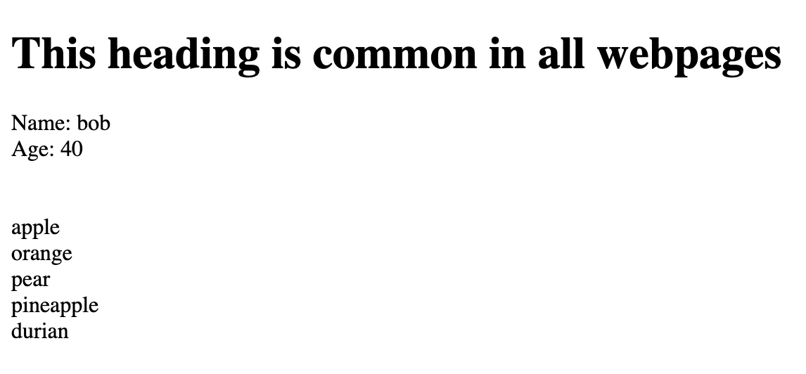
Passing values from back-end to front-end
Web page shows
@app.route('/example') def example(): fruits = ['apple', 'orange', 'pear', 'pineapple', 'durian’]
return render_template( 'examples.html', name='bob', age=40, fruits=fruits )
{%extends "base.html" %} {% block content %} <div>Name: {{name}}</div> <div>Age: {{age}}</div> <br /><br /> {% for fruit in fruits %} <div>{{fruit}}</div> {% endfor %} {%endblock%}
We will pass these values to front-end
name='bob’
age=40
fruits=fruits
Then front-end refers to the variable and display value
name='bob’
age=40
all the values in fruits using a for loop

Slide 8
Adding products to menu page
@app.route(‘/menu/') def menu(): products ={
"Espresso":["Latte","Mocha","Macchiato","Cappuccino","Americano"],
"Brewed Coffee":["Filter coffee", "Iced Coffee & Cold Brew"],
"Hot Tea":["Brewed Tea","Tea Latte"],
"Iced Tea":["Iced Tea","Iced Tea Latte"],
"Hot Chocolate":["Classic Hot Chocolate","White Hot Chocolate"]
} return render_template(menu.html', products=products)
render_template(
'products.html', products=products)
We will pass products dictionary to the page when we render the template.

Slide 9
Adding products to menu page
<h1>Products</h1> <div style="width: 50%; margin: auto"> {% for product in products %} {%if loop.index % 2 == 0 %} {% set bg_color = '#eeeeeb' %} {%else%} {% set bg_color = '#eeeebb' %} {% endif %} <div style="padding: 10px; background-color: {{ bg_color }}; margin: 20px"> <p>#{{ loop.index }}</p> <p style="font-size: 24px">{{ product }}</p> </div> {% endfor %} </div>
Use for loop to dynamically generate the products list
Add menu.html to templates folder
The products dictionary passed to this page is used to create <p> elements in the page with html.

Slide 10
Now work on your design
Add all the items in the menu
Add contents and CSS
See code samples in github: GitHub - chanyadeshani/Cofeeshop: TLevel Cofeeshop project

